Slide 1
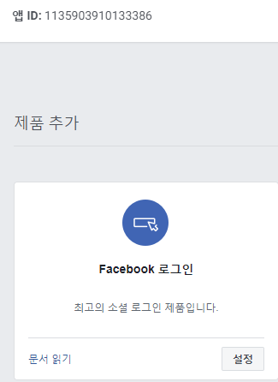
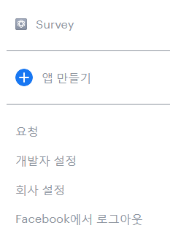
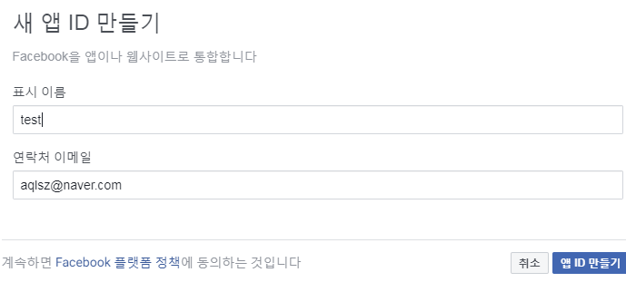
페이스북 연동 로그인
https://developers.facebook.com/?source=post_page-----7ea01508904d----------------------
에 접속한다.
2 . 내 앱 -> 앱 만들기.
3.앱 ID는 API에 필수이니 따로 적어논다.

Slide 2
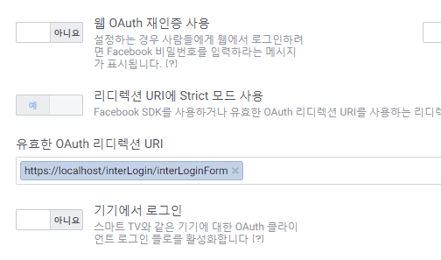
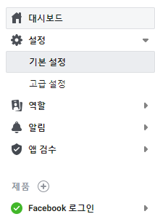
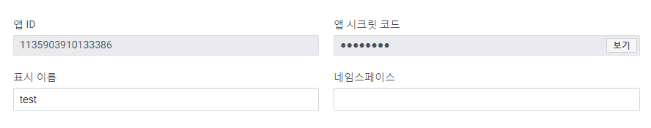
페이스북 연동 로그인
SSL을 신청하고 사용해야지 URL을 설정 해 줄 수 있다.
기본 설정을 클릭

Slide 3
페이스북 연동 로그인(sdk)
https://developers.facebook.com/docs/facebook-login/web/login-button
로그인 버튼.
https://developers.facebook.com/docs/facebook-login/permissions/
1.참고자료.
https://developers.facebook.com/docs/facebook-login/permissions/

Slide 4
페이스북 연동 로그인(java)
Pom.xml
<!-- FaceBook -->
<dependency>
<groupId>org.springframework.social</groupId>
<artifactId>spring-social-facebook</artifactId>
<version>2.0.3.RELEASE</version>
</dependency>
앱 ID
앱 시크릿 코드
버튼 클릭 시 불러올 함수 설정.
root-context.xml (의존성 추가)
<!-- FaceBook -->
<!-- FaceBook -->
<bean id="connectionFactory"
class="org.springframework.social.facebook.connect.FacebookConnectionFactory">
<constructor-arg value="1135903910133386" />
<constructor-arg value="ffceb38c2e23aca5027429ba67c7f9ab" />
</bean>
<bean id="oAuth2Parameters"
class="org.springframework.social.oauth2.OAuth2Parameters">
<property name="scope" value="email" />
<property name="redirectUri" value="http://localhost/interLogin/facebookSignInCallback" />
</bean>

Slide 5
controller(버튼 생성.)
@Autowired
private FacebookConnectionFactory connectionFactory;
@Autowired
private OAuth2Parameters oAuth2Parameters;
@RequestMapping(value = "/interLoginForm", method = { RequestMethod.GET, RequestMethod.POST })
public String interLoginForm(HttpServletResponse response, Model model) {
OAuth2Operations oauthOperations = connectionFactory.getOAuthOperations();
String facebook_url = oauthOperations.buildAuthorizeUrl(GrantType.AUTHORIZATION_CODE, oAuth2Parameters);
model.addAttribute("facebook_url", facebook_url) //버튼 안에 넣어 줄 url
System.out.println("facebook : " + facebook_url);
return "interLogin/interLoginForm";
}
Console.
facebook : https://www.facebook.com/v2.5/dialog/oauth?client_id=1135903910133386&response_type=code&scope=email&redirect_uri=http%3A%2F%2Flocalhost%2FinterLogin%2FfacebookSignInCallback
jsp
<a href="${facebook_url}"><button class="btn btn-primary btn-round"> Facebook Login</button></a>

Slide 6
controller(redirect id,name 가져오기)
@RequestMapping(value = "/facebookSignInCallback", method = { RequestMethod.GET, RequestMethod.POST })
public String facebookSignInCallback(@RequestParam String code) throws Exception {
try {
String redirectUri = oAuth2Parameters.getRedirectUri();
System.out.println("Redirect URI : " + redirectUri);
System.out.println("Code : " + code);
OAuth2Operations oauthOperations = connectionFactory.getOAuthOperations();
AccessGrant accessGrant = oauthOperations.exchangeForAccess(code, redirectUri, null);
String accessToken = accessGrant.getAccessToken();
System.out.println("AccessToken: " + accessToken);
Long expireTime = accessGrant.getExpireTime();
if (expireTime != null && expireTime < System.currentTimeMillis()) {
accessToken = accessGrant.getRefreshToken();
logger.info("accessToken is expired. refresh token = {}", accessToken);
};
Connection<Facebook> connection = connectionFactory.createConnection(accessGrant);
Facebook facebook = connection == null ? new FacebookTemplate(accessToken) : connection.getApi();
UserOperations userOperations = facebook.userOperations();
try {
String [] fields = { "id", "email", "name"};
User userProfile = facebook.fetchObject("me", User.class, fields);
System.out.println("유저이메일 : " + userProfile.getEmail());
System.out.println("유저 id : " + userProfile.getId());
System.out.println("유저 name : " + userProfile.getName());
} catch (MissingAuthorizationException e) {
e.printStackTrace();
}
} catch (Exception e) {
e.printStackTrace();
}
return "redirect:/success/success";
}

